Slide 1
Statistical Design Final Project
Russell Elbert Whitworth IV

Slide 2
Research Overview and Objective
RESEARCH OVERVIEW:
“Suppose we’d like to address the power for a new RCBD study with 6 treatments and anticipate the mean of the 4 treatments can be estimated as [80,83,86,89], and the block variance is estimated as 25, and the residual variance is estimated as 55.”
OBJECTIVE QUESTIONS:
How much power would [5, 10, 15, 20, 25, 30] blocks provide for the ANOVA F-test on treatments?
How many blocks do you need to achieve a power of 0.8?

Slide 3

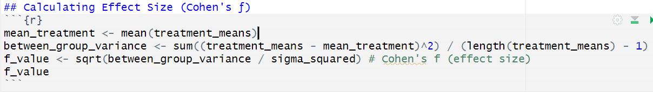

Calculating the Effect Size (Cohen’s ƒ)
Using the equation, :
The between-group standard deviation, 𝞂_{b}= √15, was calculated from the variance of the 4 treatment means.
The within group standard deviation, 𝞂_{𝓌} = √80, was calculated by combining the given block and residual variances: √(25 + 55) .
These were then plugged into the equation 𝑓 = √15 / √80 = 0.4330127. This is considered a large effect size according to Cohen’s benchmarks (large ≥ 0.4).

Slide 4
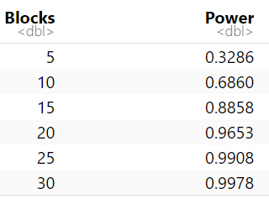
Power Analysis for Different Block Sizes
To evaluate how the number of blocks affects statistical power, I used the wp.anova() function in R to calculate power values for several block counts: [5, 10, 15, 20, 25, 30], with 6 treatments in each case. The total sample size was computed as:
𝑛 = blocks × 6
The effect size was 𝑓 = 0.4330127.
The following is an example c for 5 blocks:
On the right is a create dataset of power analysis for each block:
As the number of blocks increases, the statistical power improves substantially, approaching 1.0. This trend emphasizes the importance of sample size in detecting treatment effects.

Slide 5
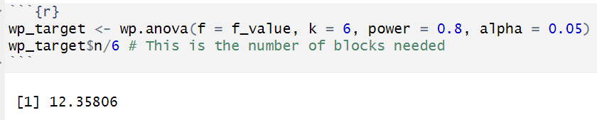
How many blocks do you need to achieve a power of 0.8?
In order to determine how many blocks are needed to achieve a power of 0.8, I used the wp.anova() function in R, setting power = 0.8 and solving for n:
Since partial blocks aren't practical in study design, we round up to the next whole number—13 blocks— to ensure the desired power is achieved.

Slide 6
Conclusions
The estimated effect size for the treatment means was large (𝑓 = 0.4330127), indicating substantial differences among groups.
Power analysis showed that power increases with the number of blocks used in the design.
To achieve the desired power level of 0.8, a minimum of 13 blocks are required in this study.
Tools like wp.anova() in R make it straightforward to plan and optimize experimental designs using effect size and variance estimates.

